Slide 1
We asked, you answered
VET leaders’ questionnaire December2022. Results

Slide 2
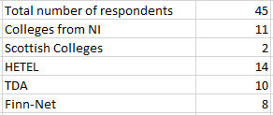
Participation Networks

Slide 3
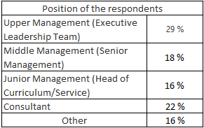
Position of the respondants

Slide 4
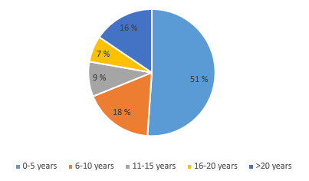
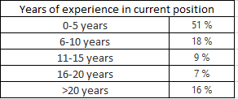
Years of experience in current position

Slide 5
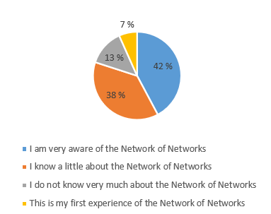
How aware are you of the Network of Network?

Slide 6
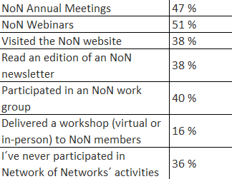
Please indicate which, if any, of these previous Network of Networks activities you have participated in

Slide 7
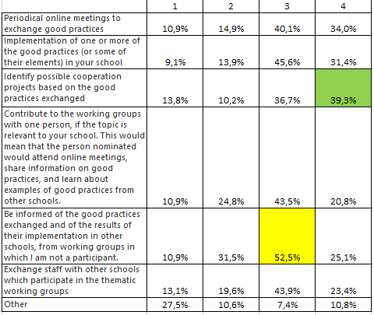
Overall results

Slide 8
What would you expect from NoN´s working groups?

Slide 9
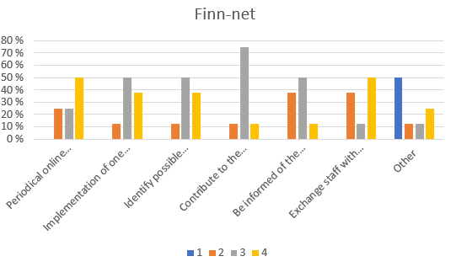
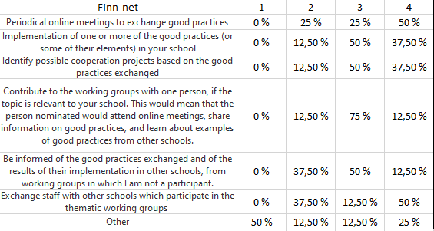
What would you expect from NoN´s working groups?

Slide 10
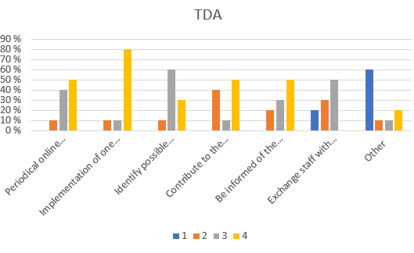
What would you expect from NoN´s working groups?

Slide 11
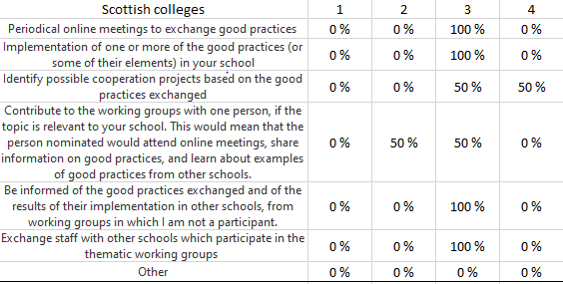
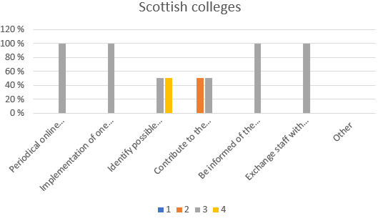
What would you expect from NoN´s working groups?

Slide 12
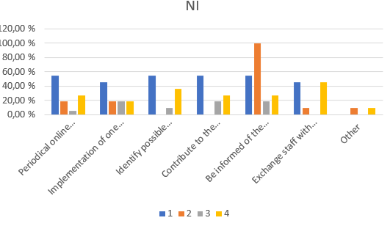
What would you expect from NoN´s working groups?

Slide 13
During the VET leaders Conference in Brussels February 2022, we will present you the strategic plan and the action plan of Network of Networks. Which aspects of these would encourage you to become more involved in duscussion with other VET Leaders?

Slide 14
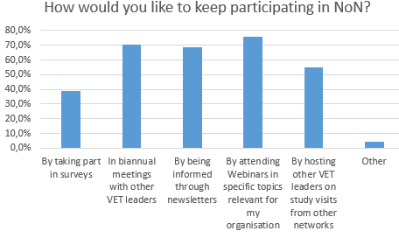
How would you like to keep participating in the NoN?

Slide 15
How would you like your school to benefit, in the coming years, from the implementation of NoN’s strage and action plan

Slide 16
Which kind of international activities has your school taken because of Covid-19?

Slide 17
Have you, personally, been involved in the activities previously mentioned in question 16?

Slide 18
If you answered ”yes” to the previous question. In which activities have you been personally involved

Slide 19
Thank you

